Slide 1
Survey of RS
Kuan Sao I
29th October 2019
Dept . of IT Cnvg. and App. Engr.
PKNU

Slide 2
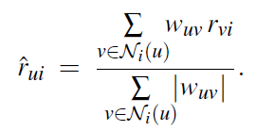
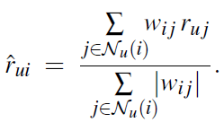
Collaborative filtering
Sybol
w | Similarity
u, v | User u , user v
r | Rating
i, j | Item i , item j
r^ | Predicted rating
Ni(u) | Neighbors of user u who rated item i
Nu(i) | items rated by user u most similar to item i.
User based
Item based

Slide 3
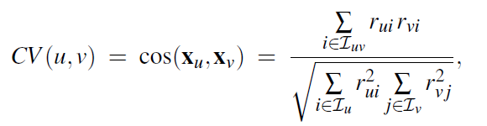
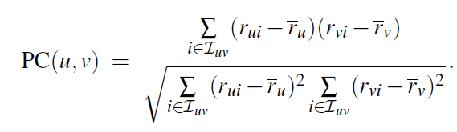
Similarity
Cosine vector similarity
Pearson correlation similarity

Slide 4
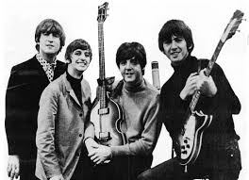


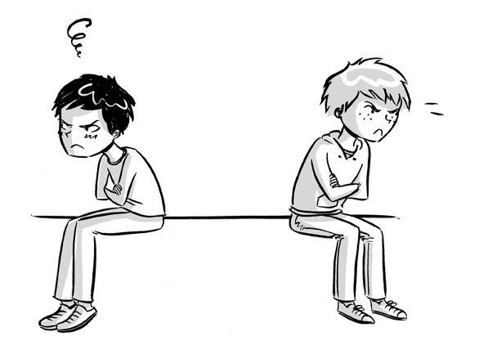
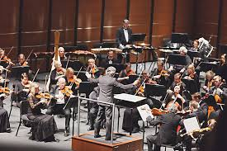

Time & social network influence
Music
2010 – Rock --→
2011 - Classic --→
2012 – Rock
Classic
Classic
-> Rock
Rock
-> Classic
Classic

Slide 5
Survey of RS papers
year | Title | Model | Cold start | Time | Neighbor / Friend | Tag / genre | Dataset
2005 | Time weight collaborative filtering | Kmeans(item) + itemCF(r*sim*f(time)) | No mention | Decay rate λ of rating time | Neighbor | Cluster item | EachMovie/ GroupLens
2010 | A Collaborative Filtering Algorithm based on Time Period Partition | Kmeans(item) + itemCF(r*sim*f(time)) | No mention | Personal decay rate λ of user rating time | Neighbor | Cluster item | MovieLens
2015 | Social Network and Tag Sources Based Augmenting Collaborative Recommender System | CF – sn - tag Sn*:Sim(nb*+fd) Tag: Sim( users – tag ) | alleviated the cold start problem by tag and social network | X | Neighbor + Friendship | Tag (tf-idf) | Last.fm / MovieLens
2017 | A Tag-based Recommendation Algorithm Integrating Short-term and Long-term Interests of Users | userCF( (r:shrot + r:long) * sim ) | No mention | Short-term and Long-term Interests of tagging time | Neighbor | X | Delicious.com(social bookmarking)
*nb: neightbor
*sn: social network
Notes:
assume that the same user has the similar preferences
and similar purchase interest changes for the similar items.
Trace each user's purchase interest change and compute automat-
ically a personalized decay factor for each user according to
his/her own purchase behaviour.

Slide 6
Comment Dataset for RS
Dataset | Users | Items | Ratings | Density | Rating Scale
Movielens 1M | 6040 | 3883 | 1,000,209 | 4.26% | [1-5]
Movielens 10M | 69,878 | 10,681 | 10,000,054 | 1.33% | [0.5-5]
Movielens 20M | 138,493 | 27,278 | 20,000,263 | 0.52% | [0.5-5]
Jester | 124,113 | 150 | 5,865,235 | 31.50% | [-10, 10]
Book-Crossing | 92,107 | 271,379 | 1,031,175 | 0.0041% | [1, 10], and implicit
Last.fm | 1892 | 17632 | 92,834 | 0.28% | Play Counts
Wikipedia | 5,583,724 | 4,936,761 | 417,996,366 | 0.0015% | Interactions
OpenStreetMap (Azerbaijan) | 231 | 108,330 | 205,774 | 0.82% | Interactions
Git (Django) | 790 | 1757 | 13,165 | 0.95% | Interactions

Slide 7
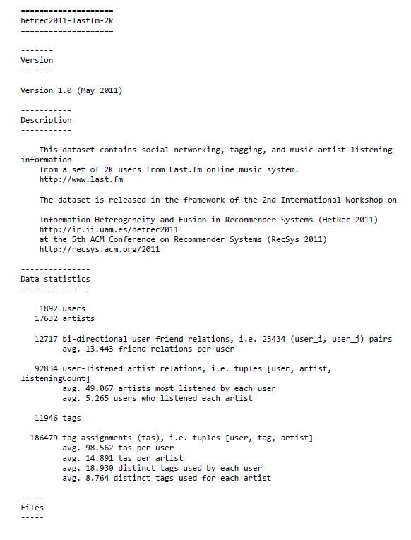
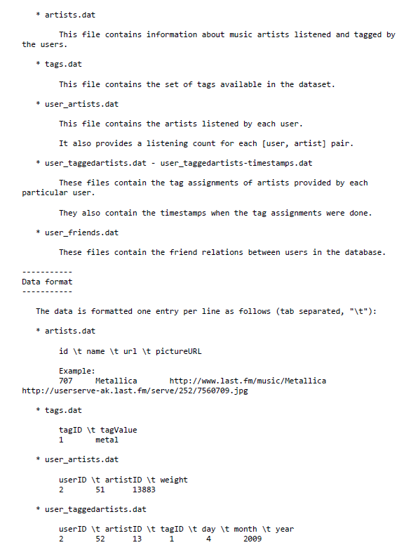

Slide 8
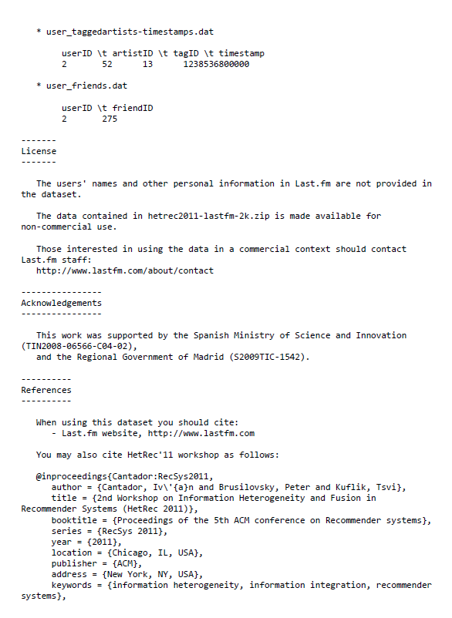
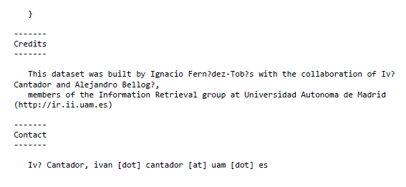

Slide 9
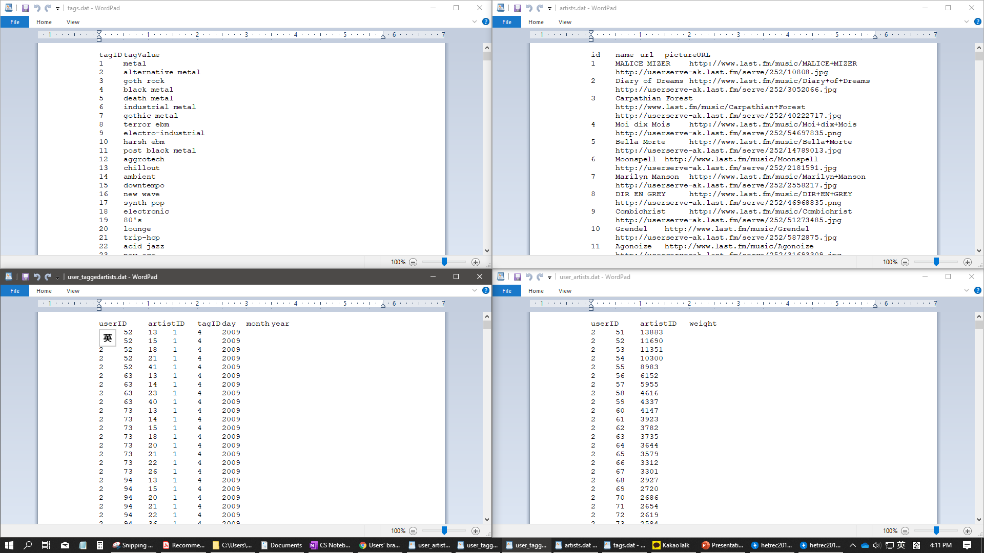
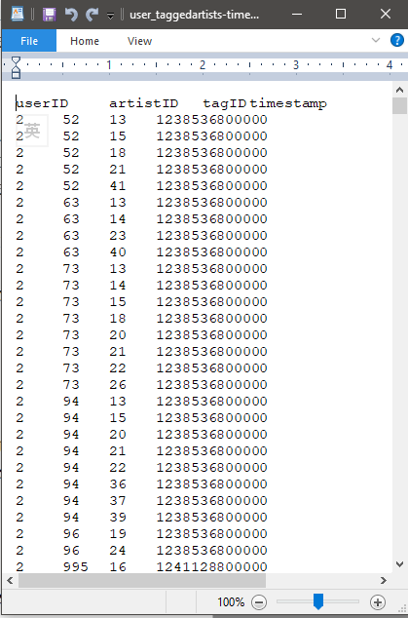

Slide 10

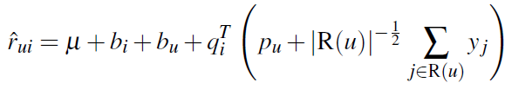
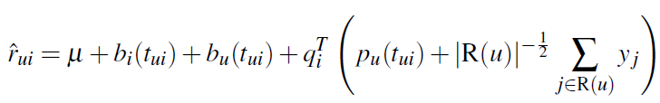
Collaborative filtering
SVD based:
Add Bias Terms in SVD
SVD++
timeSVD++
µ | overall average rating
bi, bu | observed deviations of user u and item i | Baseline predictors
qi | the coordinates of item i in this latent space
pu | the coordinates of user u projected in the k-dimensional latent space
yj | yj is f dimensions vector, where f is number of factors. | ≈0(regularization)
R(u) | The set R(u) contains the items rated by user u.
t | time
Complemented: latent preference of pu
Notes:
https://ieeexplore.ieee.org/abstract/document/6976489

Slide 11
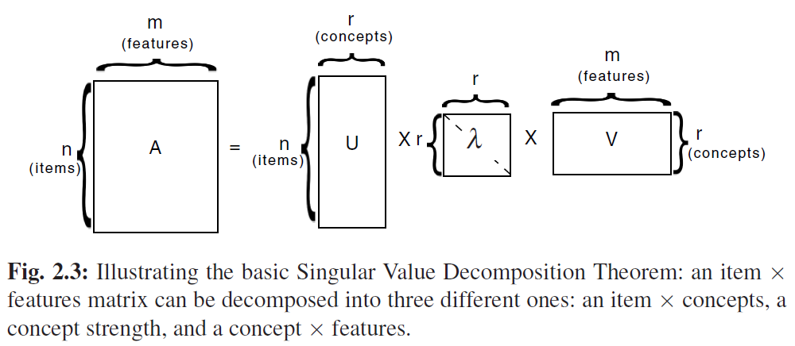



SVD
SVD algorithm : decompose a given matrix A into
A =UλV(Transpose) .

